Slide 1
HAZARD COMMUNICATION
Chemical hazards in the workplace

Slide 2
Objective
To inform employees about:
Chemical hazards in the workplace
Material Safety Data Sheets (MSDS)
Labeling requirements

Slide 3
Background
On any given day, 32,000,000 workers are potentially exposed to chemical hazards in the workplace
There are an estimated 575,000 existing chemicals, with more added daily
Chemical hazards cause or contribute to heart, kidney, and lung damage
Chemicals cause fires, explosions and other serious accidents

Slide 4
Chemicals in your workplace
These chemicals are present in your workplace
Their hazards
How to protect yourself from those hazards

Slide 5
Two types of hazards
Physical hazards
Produce a dangerous situation outside the body (burns, explosions, etc.)
Health hazards
Acute health hazards do their damage rapidly from short-term exposure
Chronic health hazards affect the body slowly through long-term exposure

Slide 6
How to protect yourself
Training
Use less hazardous substance
Personal protective equipment (PPE)
Know location of first aid washes or showers
Handling and storage procedures
Read the MSDS

Slide 7
Material Safety Data Sheets (MSDS)
Current MSDS must be readily available for each chemical in the workplace
MSDS must give employees and employers detailed information about hazards of specific materials and how to control them

Slide 8
Each MSDS must include
Common name/chemical name
Name, address, phone number of manufacturer
Emergency numbers for immediate info on specific hazards
Date form was written/last revised
Hazardous ingredients and info about them

Slide 9
Each MSDS also should include
Fire and explosion information
Material’s flash point
Auto ignition temperature
Upper and lower flammability limits
Material to use to put out the fire
Special fire-fighting requirements
Fire/explosion hazard

Slide 10
Each MSDS also should include
Chemical reaction dangers
Whether chemical itself is stable or unstable
Conditions and other materials which can cause reaction
Dangerous substances that can be produced when it reacts
For example: mixing chlorine and ammonia produces a toxic gas

Slide 11
Each MSDS also should include
Measures to control hazards
Engineering controls
Personal Protective Equipment (PPE)
Safe storage of chemicals
Safe handling practices

Slide 12
Each MSDS also should include
Health hazard information
Safe exposure limits
Acute/chronic symptoms of exposure
Main route of entry into the body
inhalation, ingestion, absorption, injection
Medical conditions that can worsen
Whether the chemical can cause cancer
Emergency first-aid treatments

Slide 13
Each MSDS also should include
How to deal with spills
Clean-up techniques
Personal protective equipment (PPE) to be used during clean-up
How to dispose of waste materials

Slide 14
Labeling requirements
Warning labels are your first indication of how to approach and handle the chemical
Alert you to the dangers or hazards
Might not tell you everything you need to know about controlling these dangers

Slide 15
Labeling requirements
Labels are required on:
All containers of hazardous material in the workplace, including secondary containers
tip and pours
gas cans
Containers being shipped from one workplace to another

Slide 16
Labeling requirements
Warning labels must give the following information:
Name of the material
All physical hazards
All health hazards

Slide 17
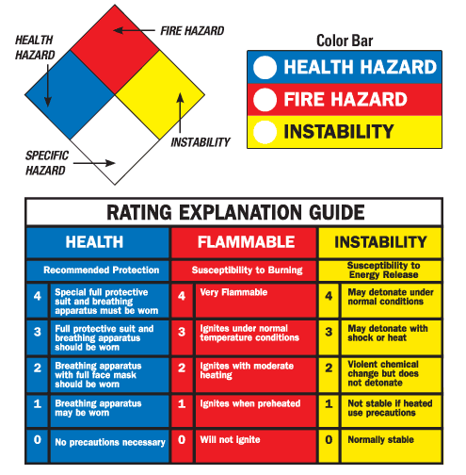
Sample labels
National Fire Protection Agency labels

Slide 18
Review
Know the hazards of the specific chemicals that you will be working with in your workplace
Know where your company’s MSDSs are kept
Know how to read and understand an MSDS
Labels are required on all containers in the workplace

